Slide 1
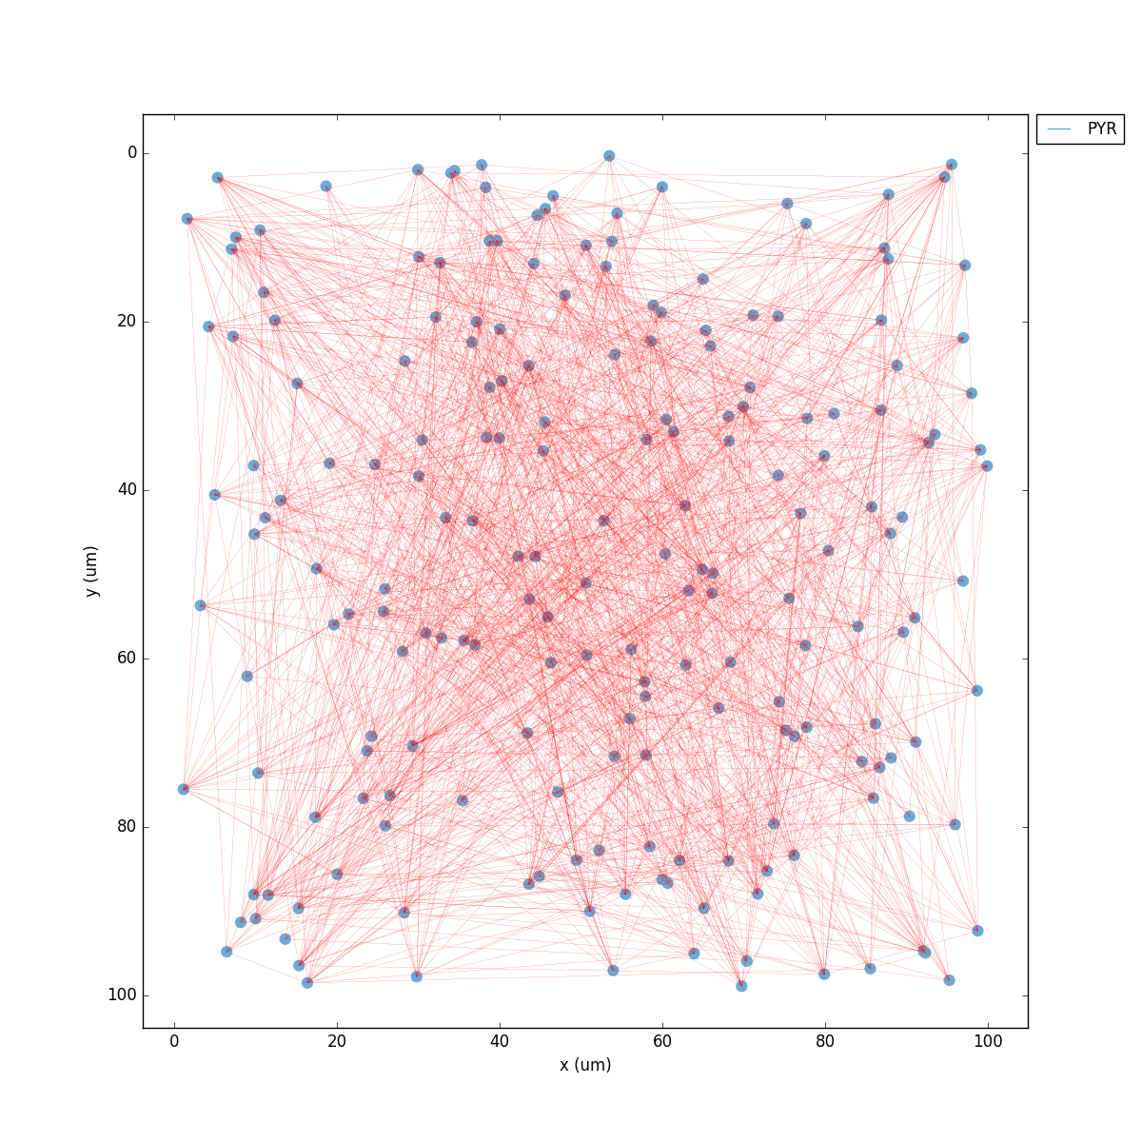

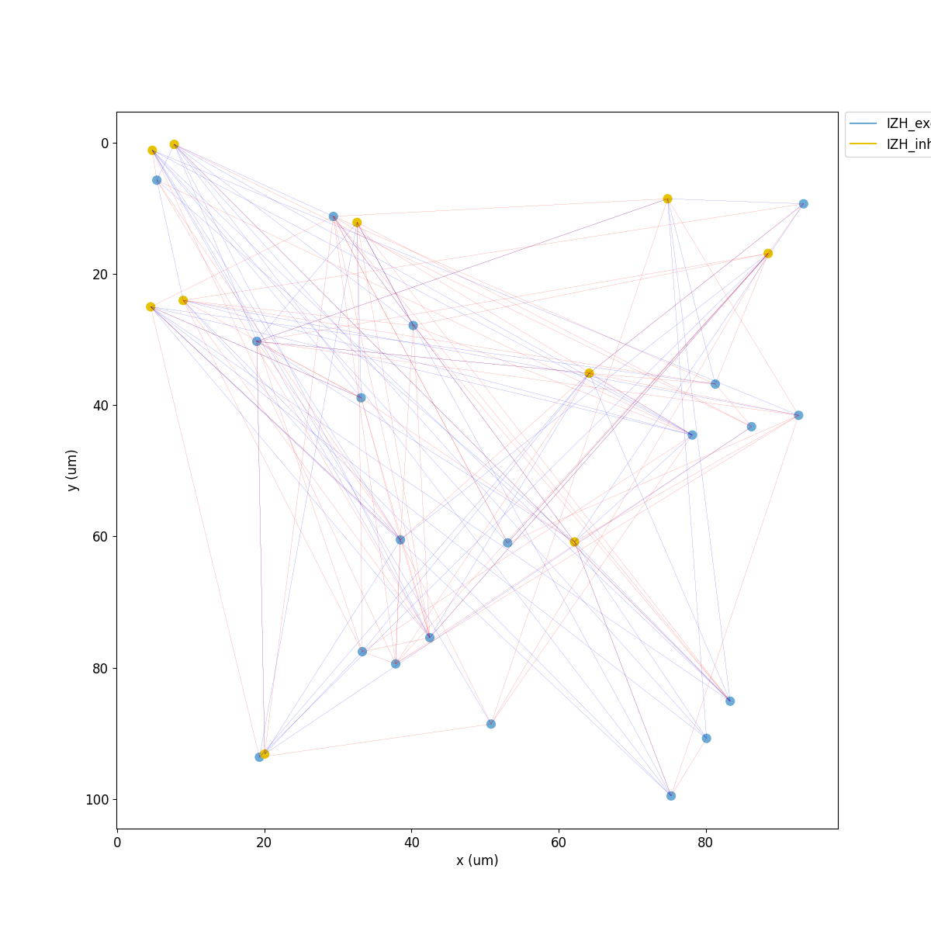
Hands-on Workshop: Building & Simulating Neural Networks with NetPyNE

Slide 2
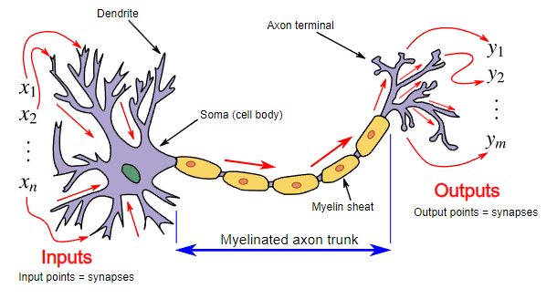
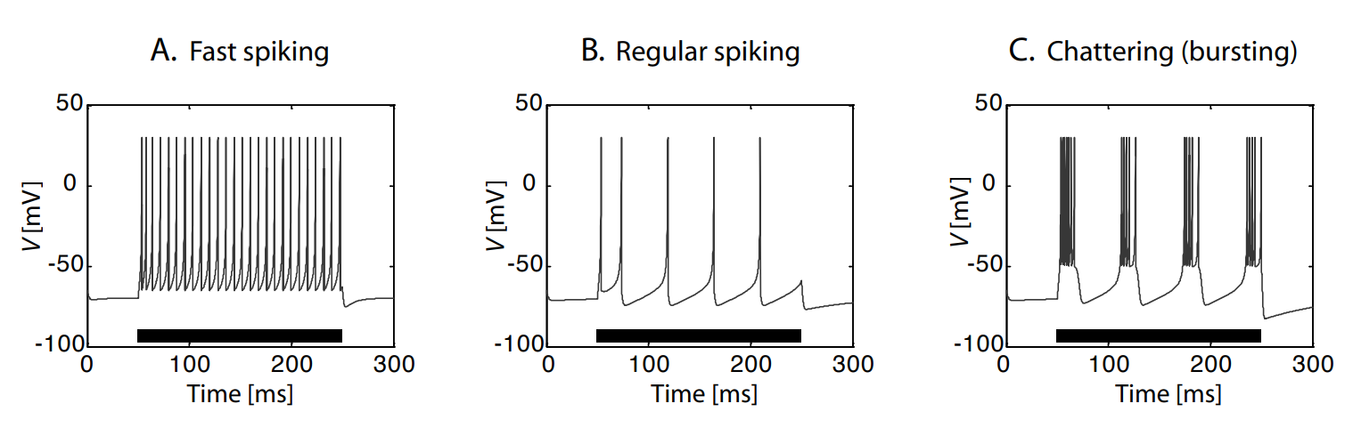
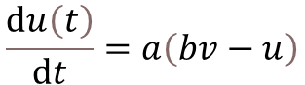
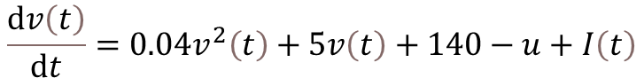
Mathematical Modeling of Neurons
Izhikevich Neuron Model
Biological neuronal model
Membrane Potential ($v$):
$$\frac{ⅆv\left(t\right)}{ⅆt}=0.04v^{2}\left(t\right)+5v\left(t\right)+140−u+I\left(t\right)$$
Recovery Variable ($u$):
$$\frac{ⅆu\left(t\right)}{ⅆt}=a\left(bv−u\right)$$
Different spike pattern of a Izhikevich neuron(neuronal Behavior)
Fundamentals of Computational Neuroscience Third Edition Thomas P. Trappenberg Dalhousie University

Slide 3
Definition of Parameters
Typical Parameter Values for Different Neuron Types
Parameter | Symbol | Typical Values | Description
Membrane Potential | v | -65 to 30 mV | Represents the neuron's voltage over time
Recovery Variable | u | -14 to -10 pA | Tracks slow adaptation and resets the neuron after a spike
Input Current | I(t) | 0 - 20 pA | External stimulation applied to the neuron
Time Constant of Recovery | a | 0.01 - 0.1 | Defines the timescale of recovery variable u
Sensitivity of Recovery | b | 0.1 - 0.2 | Determines the response of u to changes in v
Reset Voltage After Spike | c | -65 to -50 mV | Resets the neuron’s voltage after a spike
Reset of Recovery Variable | d | 2 - 8 pA | Controls how much the recovery variable increases after a spike
Neuron Type | a | b | c | d | Behavior
Regular Spiking (RS) | 0.02 | 0.2 | -65 | 8 | Standard cortical neuron
Intrinsic Bursting (IB) | 0.02 | 0.2 | -55 | 4 | Produces bursts of spikes
Chattering (CH) | 0.02 | 0.2 | -50 | 2 | Very high firing rate
Fast Spiking (FS) | 0.1 | 0.2 | -65 | 2 | Inhibitory interneurons
Low-Threshold Spiking (LTS) | 0.02 | 0.25 | -65 | 2 | Slow-adapting inhibitory neurons
Resonator (RZ) | 0.1 | 0.26 | -65 | 2 | Shows resonance-like behavior

Slide 4
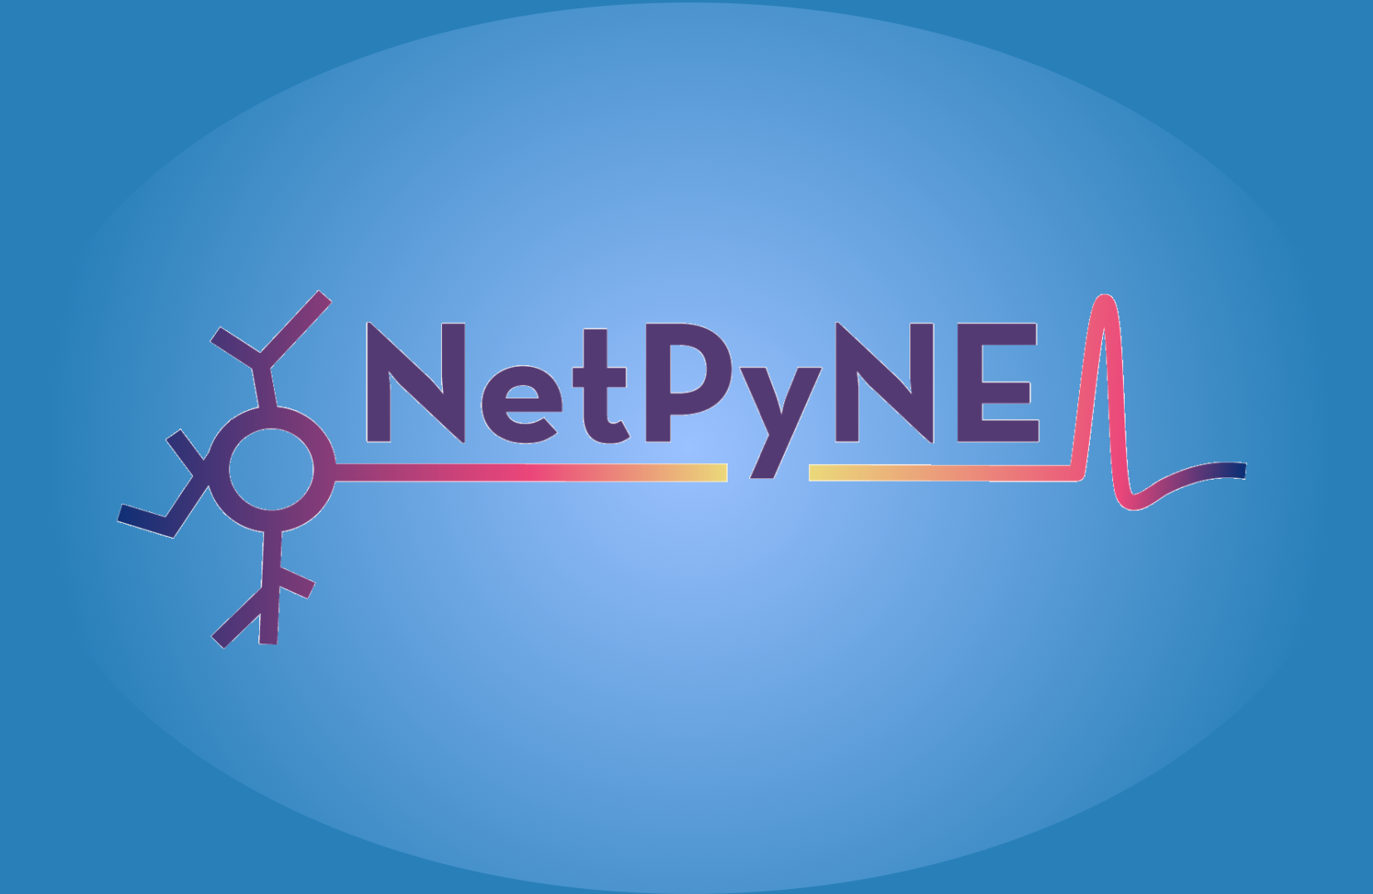
What is NetPyNE?
A Python package for creating and simulating spiking neural networks using NEURON.
High-level, intuitive interface for neuroscience research.
Why Use NetPyNE?
Easy model definition
Automatic network visualization

Slide 5

Installing
Hands-on Exercise 1 - Simulating a Single Neuron
!pip install neuron
!pip install netpyne
!nrnivmodl
Simulate a single Izhikevich neuron.
Inject current (IClamp) and observe firing patterns.
1) izhi200b.mod
2) Python File: single_izhikevich.py

Slide 6
Hands-on Exercise 1 !☺
(For Simulating a Single Neuron)
Increase input current: Change `amp` in `IClamp` from 10 to 20 pA → Does the neuron fire more frequently?
Modify adaptation: Change `b` in the neuron model from -2 to -1 → Does the firing pattern change (faster or slower adaptation)?
Change reset voltage (`c`): Modify `c` from -50 to -55 mV → Does this affect how quickly the neuron recovers after a spike?
Increase membrane capacitance (`C`): Change `C` from 1 to 2 → Does a larger capacitance slow down the response of the neuron?
ummary of Expected Changes
Expected Observations
Parameter Change | Effect on Firing | Why?
Increase input current (10 → 20 pA) | More frequent spikes | Higher I accelerates v reaching vpeak
Decrease b (-2 → -1) | Slower adaptation | Weaker inhibitory effect on u, neuron continues firing
Decrease c (-50 → -55 mV) | Longer recovery time | Voltage resets further from threshold, slowing down firing
Increase C (1 → 2) | Slower response | Higher capacitance means slower voltage change

Slide 7
Hands-on Exercise 2 - Building a Network of 20 Neurons
Create a network of 20 Izhikevich neurons.
Apply random Poisson stimulation (NetStim).
In neuroscience, it models synaptic input from external sources, like sensory stimulation or background noise.
Observe spike activity using raster plots.
Python File: izhikevich_network.py
Expected Plots:
2D network visualization
Raster plot (spike activity)
Voltage trace (activity of a single neuron)

Slide 8
Hands-on Exercise 2 !! ☺☺
(For Building a Network of 20 Neurons)
Increase connectivity: Change the connection probability (probability) from 0.1 to 0.5 in IZH->IZH → How does increased connectivity affect firing patterns?
Increase synaptic weight: Change 'weight': 0.005 to 'weight': 0.02 in excitatory synapses → Does stronger synaptic input lead to more synchronized activity?
Increase number of neurons: Change 'numCells': 20 to 'numCells': 50 → How does increasing network size influence overall activity and spike rate?
Modify external input (Poisson stimulation): Change rate in NetStim from 100 to 200 Hz → Does higher Poisson input increase or decrease network synchrony?
Expected Observations
Parameter Change | Expected Effect
Higher connectivity (probability = 0.5) | More neurons connected, increased firing synchrony.
Higher synaptic weight (weight = 0.02) | Stronger synaptic transmission, higher activity.
More neurons (numCells = 50) | Larger network, denser activity.
Higher Poisson rate (rate = 200 Hz) | Increased randomness, more frequent firing.

Slide 9
Hands-on Exercise 3 - Adding Inhibition to the Network
Add 10 inhibitory neurons to our existing network.
Define inhibitory synapses with Exp2Syn.
Analyze how inhibition affects firing patterns.
Type | Neurotransmitter | Receptors | Effect on Post-Synaptic Neuron | Example in Code
Excitatory | Glutamate (Glu) | AMPA, NMDA, Kainate, mGluRs | Depolarization (↑ Na⁺, Ca²⁺ influx) → More likely to fire | 'e': 0 in Exp2Syn
Inhibitory | GABA (brain), Glycine (spinal cord) | GABA-A, GABA-B, Glycine | Hyperpolarization (↑ Cl⁻ influx) → Less likely to fire | 'e': -70 in Exp2Syn
Expected Changes in Plots:
Less synchronized firing
Lower excitatory firing rate
More realistic spiking pattern
Python File: izhikevich_inhibitory_network.py

Slide 10
Hands-on Exercise 3 !!!☺☺☺
Increase inhibition: Change 'e': -80 in the inhibitory synapse → Stronger GABAergic effect.
Increase excitation: Change 'e': 10 in the excitatory synapse → More depolarization.
Raster Plot Analysis
Voltage Traces
How to Interpret?
Neurons spike based on excitatory & inhibitory input
Look for bursts, suppression, and adaptation.
Each dot represents a spike of a neuron.
X-axis = Time (ms), Y-axis = Neuron ID.
Excitatory neurons (blue) vs Inhibitory neurons (yellow).Reduced synchrony due to inhibition.
Observation from Our Model:
Inhibition causes fluctuations in firing patterns.
Spikes are irregular due to external Poisson input (NetStim).
Observation from Our Model:
Excitatory neurons fire at ~29.8 Hz.
Inhibitory neurons fire at ~36.8 Hz.
Expected Changes
Parameter Change | Effect on Firing | Why?
Increase Inhibition (e = -70 → -80 mV) | Less firing, more suppression | Stronger hyperpolarization (GABAergic effect)
Increase Excitation (e = 0 → 10 mV) | More frequent spiking | Stronger depolarization drives neuron towards threshold

Slide 11
Summarize:
We built a network of Izhikevich neurons using NetPyNE.
We simulated both excitatory and inhibitory activity.
We analyzed network dynamics using raster plots & voltage traces.
Further Experiments to Try!!!!!!!!!!!☺
Change connectivity probability (connParams).
Modify Izhikevich neuron parameters (a, b, c, d).
Increase inhibition and check its impact on network stability.

Slide 12
Thank You !! ☺ ☺ ☺

Slide 13
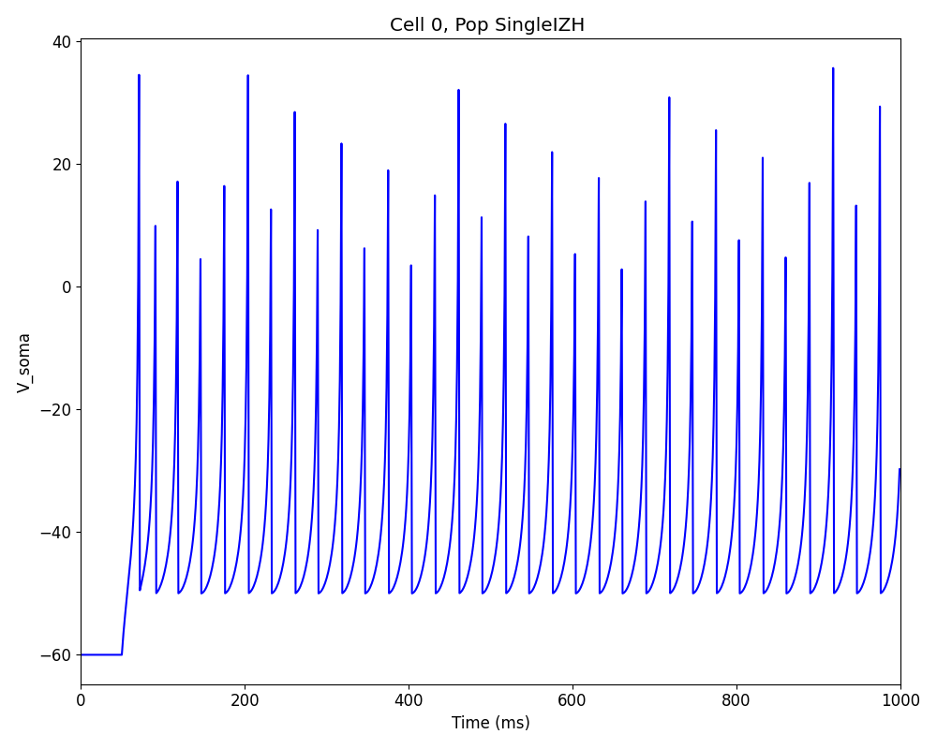
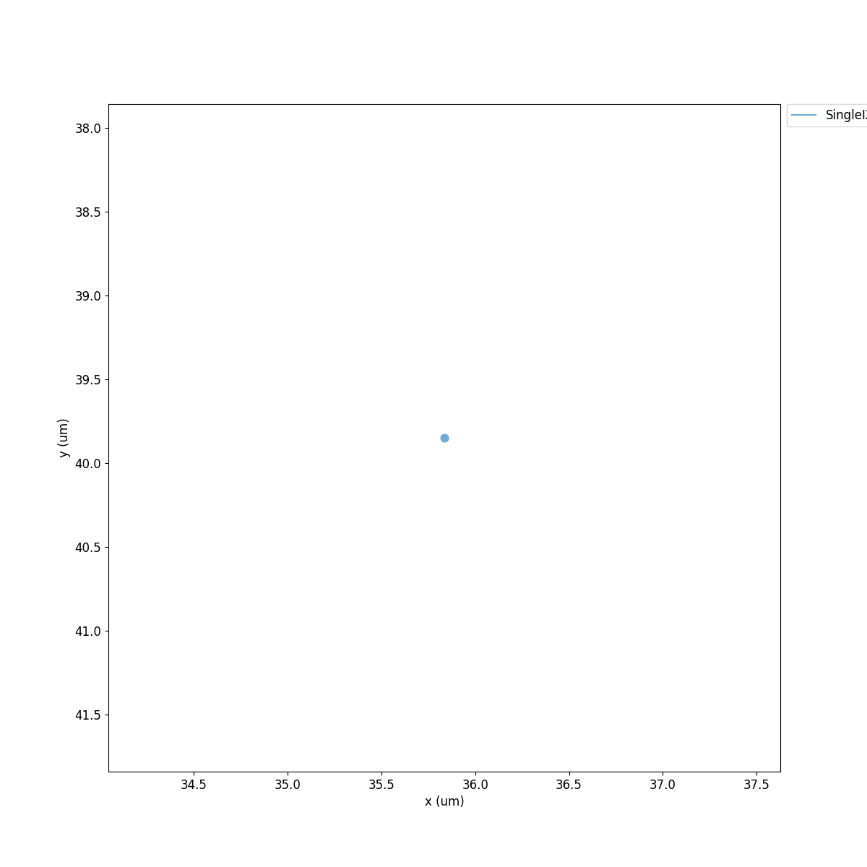
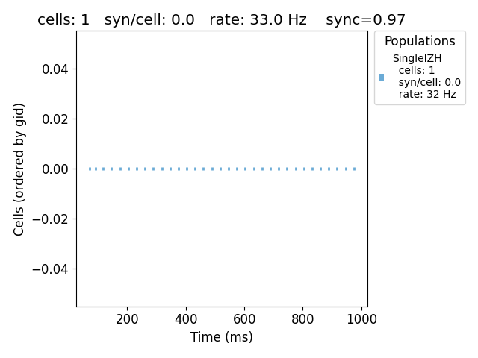
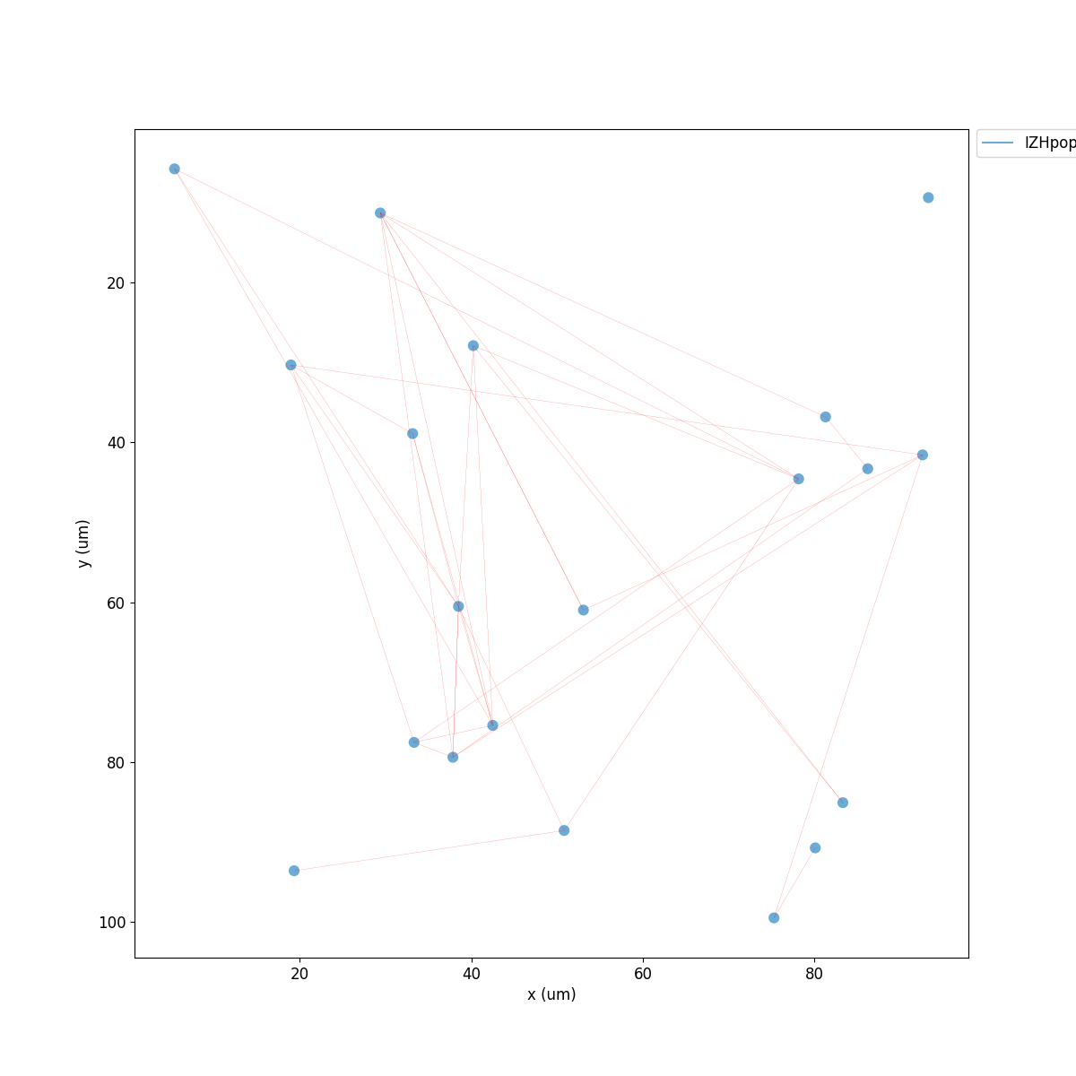
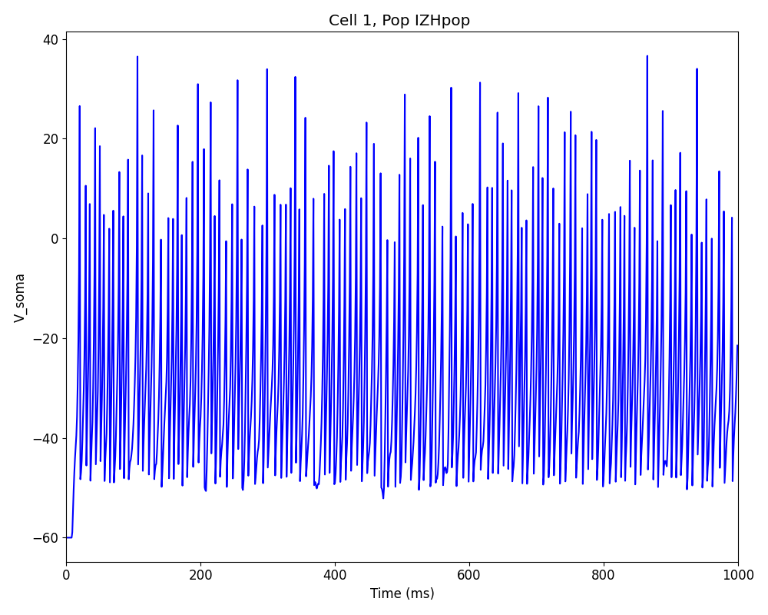
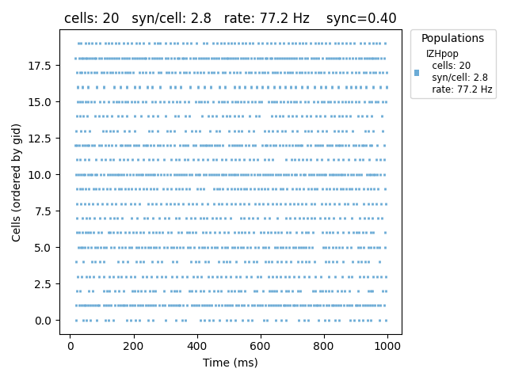

Slide 14
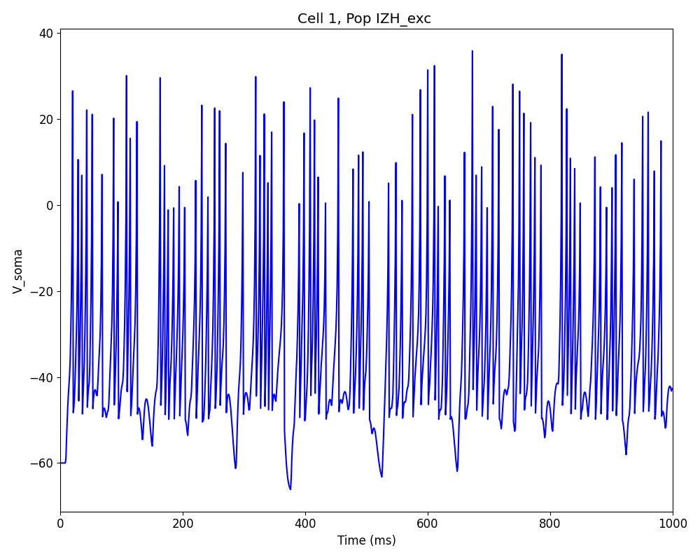
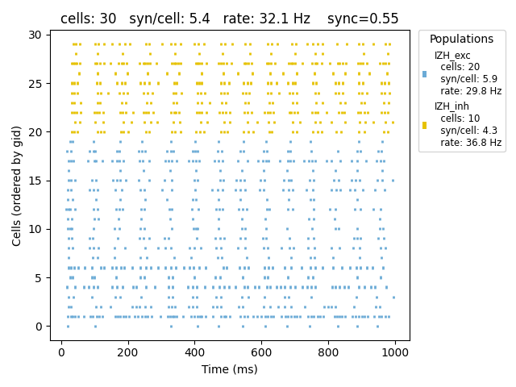
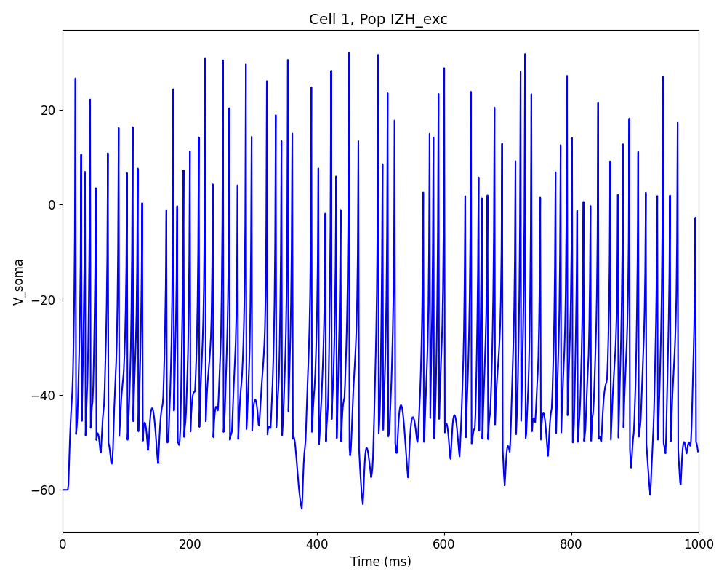
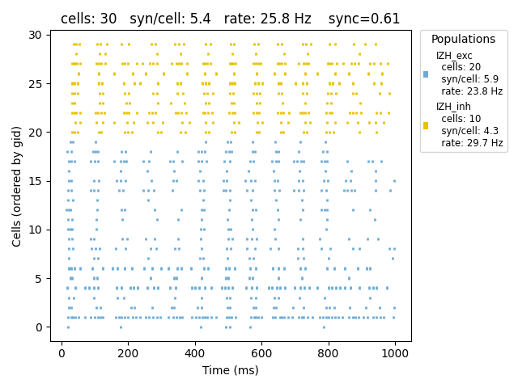
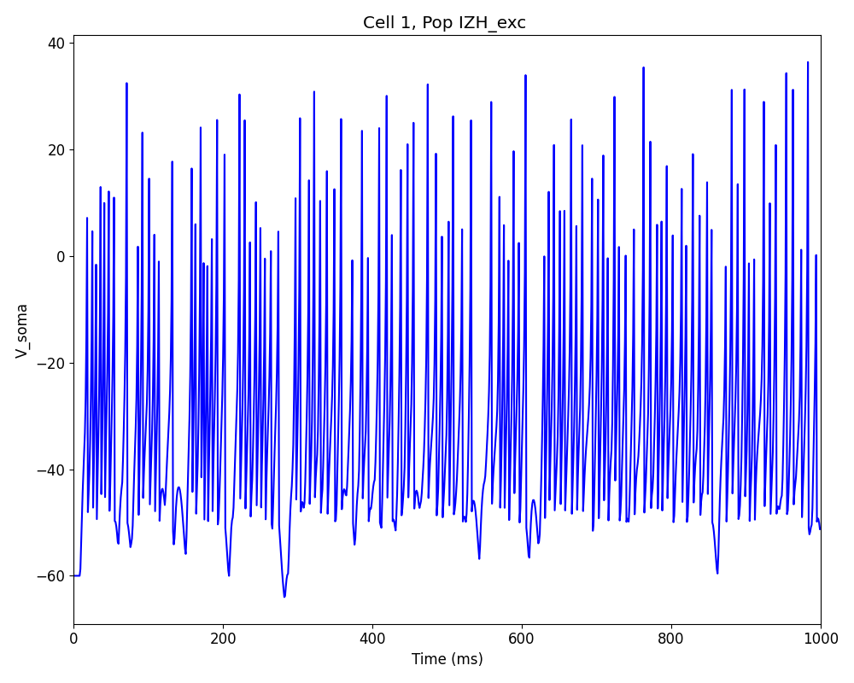
e: -95 for inh
e: 10 for exc

